Slide 1

Outside Cover

Slide 2
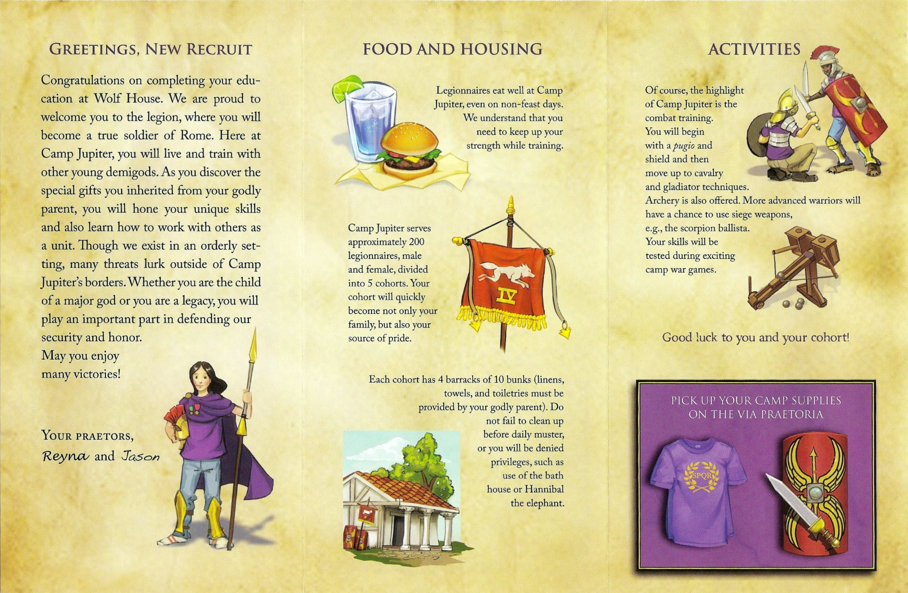
Inside Cover

